Slide 1
Travel
Ziyao He
Notes:
Hello I am Ziyao He, the topic and the group name of my project is Travel

Slide 2
Overview
Introduction
Dataset
Possible Interactions
Notes:
So my presentation is about 3 parts: Introduction the topic, general view of Dataset, some Possible Interactions based on the data I get as far as I can come up with

Slide 3
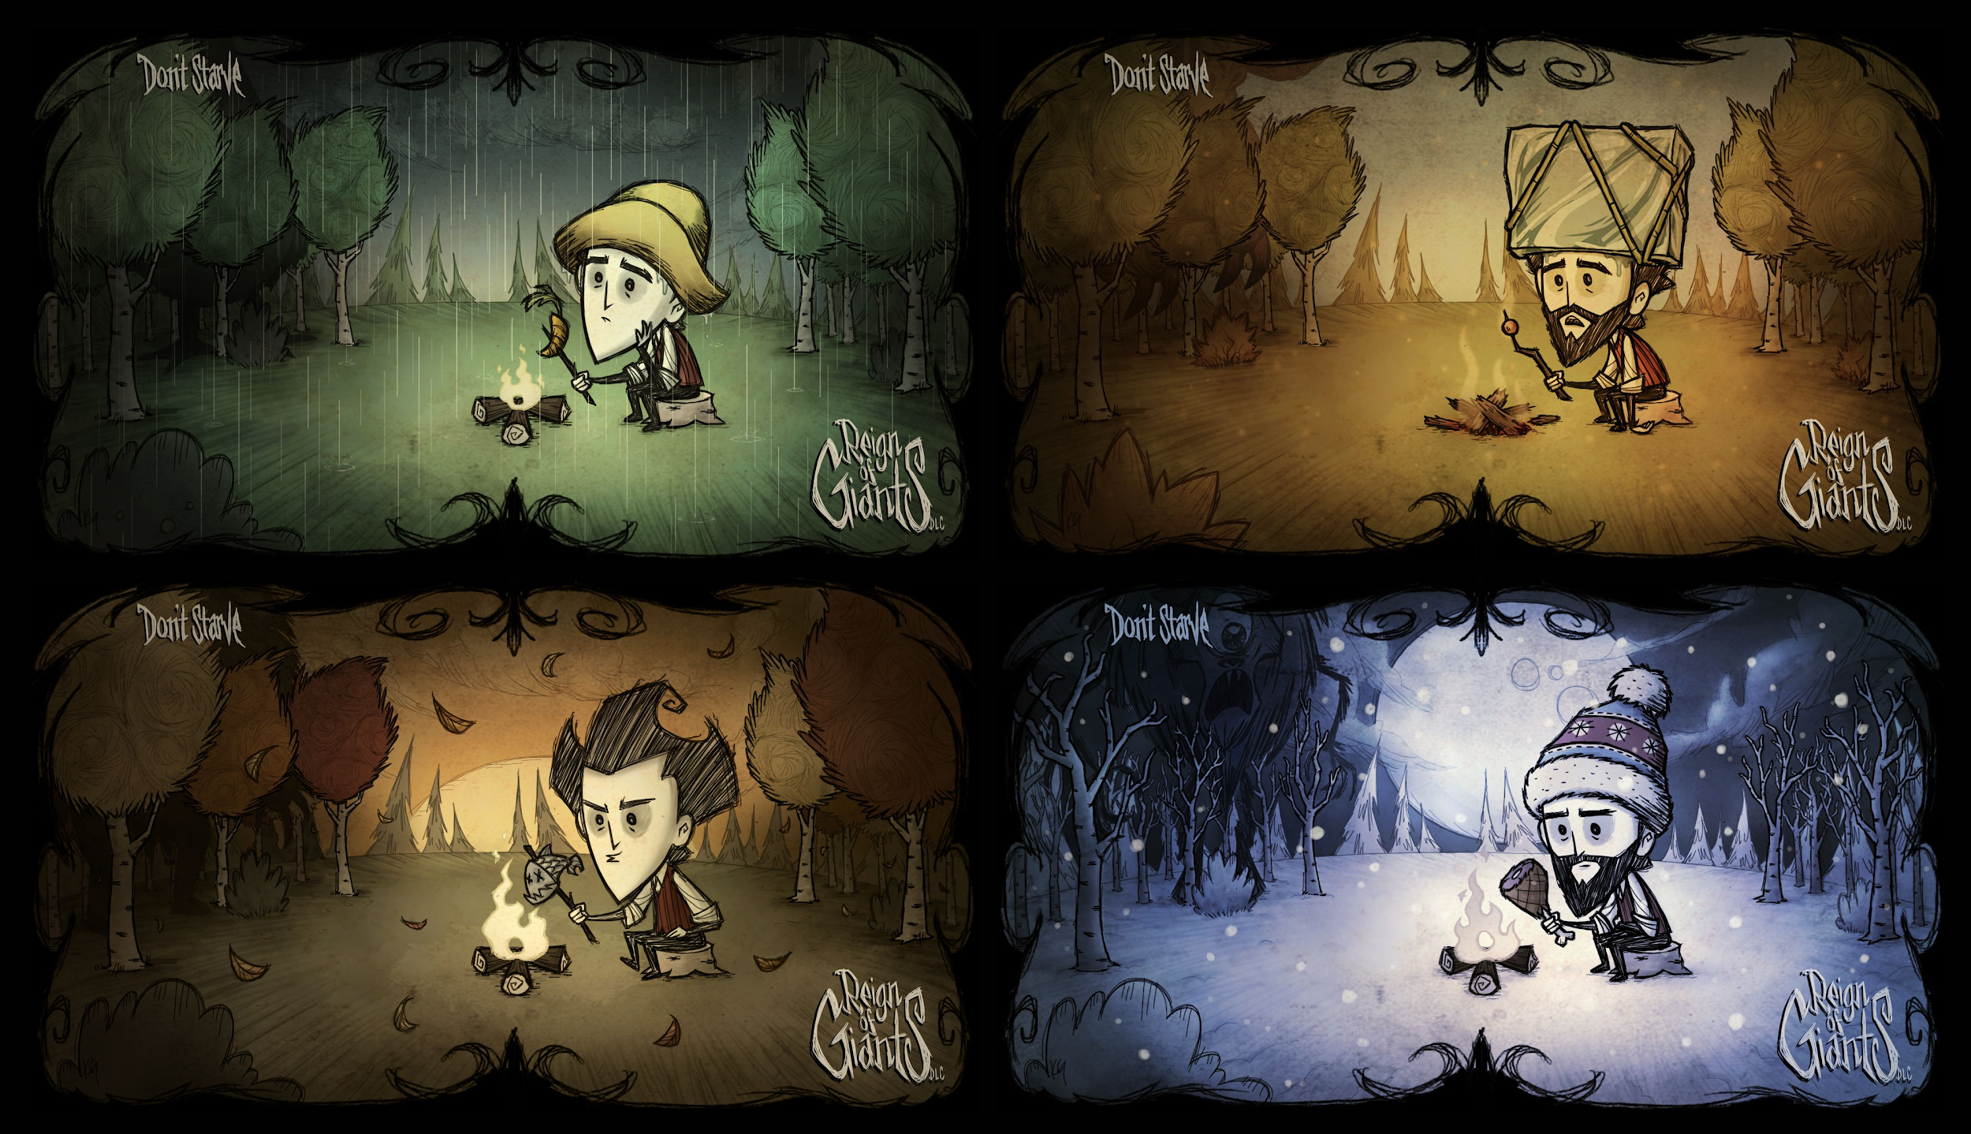
Campsites Dataset
Notes:
These are the pictures from don't starve. So my project topic is adventure——see different campsites

Slide 4
Attributes
['city', 'country', 'county', 'distance', 'excerpt', 'id', 'latitude', 'longitude', 'name', 'rating', 'ratings_average', 'ratings_count', 'ratings_value', 'region', 'table_row', 'type', 'type_specific', 'url']
Notes:
There are different attributes for every campsite, I colored yellow the attributes that I want to implement, colored blue to the attribute that can be useful to the project

Slide 5

“Interesting” Properties
Most of the campsites are from US, Some of them are from Canada, Mexico, None
Distance
Rating Counts = 0 leads to Rating Average = 0
types=campsites
type_specific
Notes:
As for distance we can't say more about the information since we don't have the consistent starting point to measure the distance
Some campsites that nobody rats or comment before get rating average=0 but doesn't mean that is a bad place
all types are campsites
For example:
type_specific[1012]:
{'amenities': '',
'activities': '1073',
'fee': 'Free',
'icon': 'https://freecampsites.net/wp-content/themes/freecampsites/images/map-icons/fc_icon-tent-green-24x24.png'}
hopfully all of the campsites are free.

Slide 6
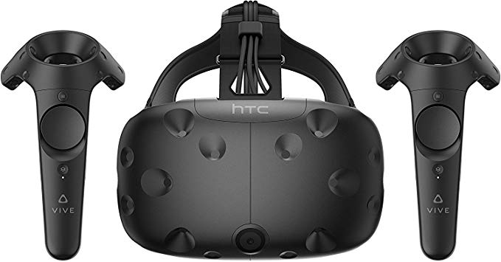
Simulation
Short view of campsites from different places. (To see the rating of the campsites maybe some pictures of campsites)
Travel around at home with virtual reality. (Scale between map and person)
See the whole view of campsites can help to set up the journey plan.
Notes:
At first I thought there is no need to do the 3D earth map, since there are only 4 Contries in the dataset. The benefit we can get from VR is you can like a bird traveling around the world compare to 2D map. And according to the map you see in virtual reality it is easier to set up a traveling plan.

Slide 7
Initial ideas
Notes:
So the challenge for me is to scale the map to fit the large of one person and project the longitude and altitude from real world to 3D map.
this is a gif from wrld3d the first thing for me is to implement the 3D world and make the camera avaliable to look around. Hopfully also travling around with human scales. The geometry of places can be problem since we can't really climb in VR so may be add a button to climb or make user flying in the sky.

Slide 8
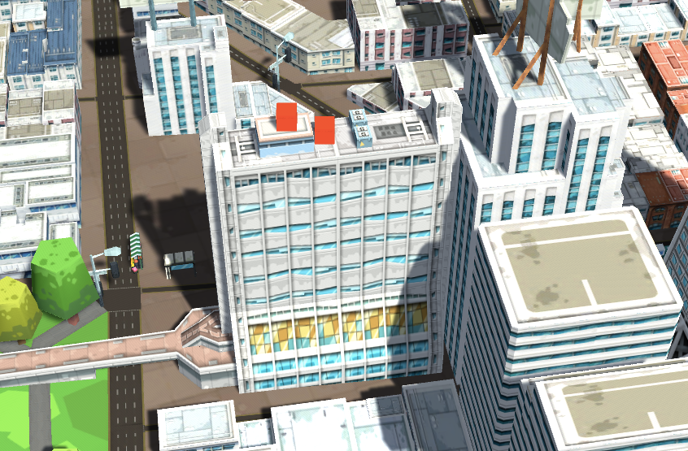
Notes:
This is a screen shot of placing objects in the 3D scene. So that maybe user can add some objects as marker to help user set up the plan. That is all thank you!

